Slide 1
Variance in Market Reaction to Stock Listing Method:
Direct vs. Indirect Listing
Jonathan Bate | 101005959
Victoria Cerqueira | 100997562
Cameron Goodkey | 101004735
Hussam Hammad | 100986708

Slide 2
Introduction & Motivation
Stock market provides firms with the opportunity to expand financial leverage and recognition
Historically direct listing methods, mainly IPOs have been the major entry method into the market
Indirect listing has recently become a possibility
Mainly happening through reverse mergers where private companies take over public companies
Study examines the ability for firms to efficiently access public funds through different entry methods (Direct vs Indirect)
As indirect listing have only recently been introduced, there is limited data on them
Empirical evidence suggests direct listings are a more optimal public entry method, yet this study further analyzes and consider the optimal market performer

Slide 3
Literature Review
In developed markets...
The choice between reverse merger and standard IPO listing is directly related to the quality of the firm
Underperformance of a firm is tied to the pre-listing performance gap
High quality firms, when listing, will more often opt for traditional IPOs rather than reverse mergers

Slide 4
Literature Review
In emerging markets...
Indirect listing methods perform better than direct listing methods
Evidence suggests a correlation between the duration of going public and the post-listing performance
Managers benefit from using this model overall given the access to public markets without a major disclosure of information

Slide 5
Literature Review
On a cost basis...
Indirect listing methods, such as backdoor-listing, are regarded to be both faster and cheaper as compared to IPOs
Though, there are hidden liabilities
Financial and Economic implications…
There is less institutional interest in indirect issuance as well as less sound fundamental qualities and earnings potential
Due to the reduced transparency and information asymmetry

Slide 6
Literature Review
Overall…
Indirect methods:
Are not always effective growth mechanisms
Are good alternatives for small companies lacking time and capital
Are riskier
Direct methods (IPOs):
Are less risky
More expensive
Better regulated

Slide 7
Research Questions
Overall Performance
Risk & Liquidity
Financial Position
Do firms entering the market through IPOs returns outperform reverse mergers in the short and long term?
Which entry method provides the firm with a lower level of risk and higher level of liquidity?
Does the financial position, leverage, solvency, and profitability status of the firm play a role in the performance of listing method?

Slide 8
Hypothesis Tests
Overall Performance
Risk & Liquidity
Financial Position
Ho: Using an indirect listing method, such as reverse mergers, to gain entry into the public market will result in a more optimal cumulative return relative to an IPO comparable.
Ha: Using an indirect listing method, such as reverse mergers, to gain entry into the public market will result in a similar or less optimal cumulative return relative to an IPO comparable.
Ho: Using an indirect listing method, such as reverse mergers, to gain entry into the public market will result in a lower risk and higher liquidity relative to an IPO comparable.
Ha: Using an indirect listing method, such as reverse mergers, to gain entry into the public market will result in higher risk and lower liquidity relative to an IPO comparable.
Ho: The performance of firms through direct-listing method is common among firms with higher profitability, lower levels of solvency and leverage.
Ha: The performance of firms through indirect-listing method is common among firms with higher profitability, lower levels of solvency and leverage.

Slide 9
Data
Source: Bloomberg
Stock closing prices, trading volumes and all other necessary financial information
Filters
All actively traded stocks listed on U.S. exchanges
Time Period
January 2000 - February 2019

Slide 10
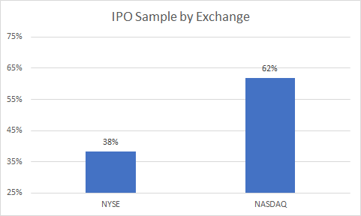
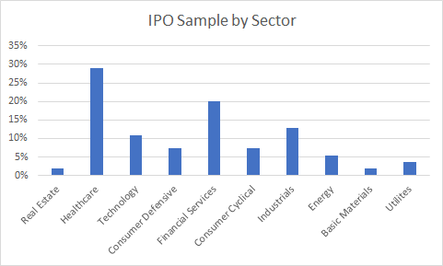
IPO Sample
55 Firms
Randomly selected
Each firm performed IPO on U.S. exchange between 2000 and 2019

Slide 11
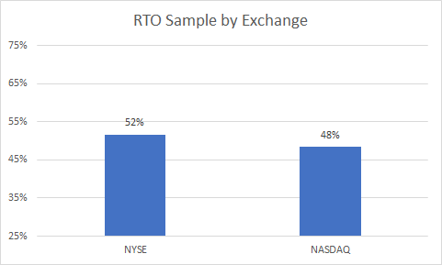
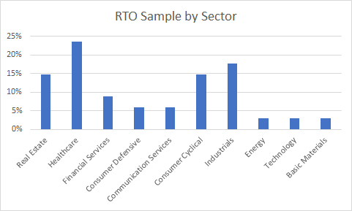
RTO Sample
39 firms
Each firm performed reverse merger in the U.S. between 2000 and 2019

Slide 12
Methodology
Regression performed in order to explain variance in abnormal returns for firms in each sample
S&P United States BMI (SBBCUSU) used as the benchmark to track variance in stock returns
Regression Equation:

Slide 13
Methodology
The first factor measures liquidity, proxied by trading volume
Used to determine whether IPO or RTO firms were more liquid
The second factor measures profitability (t-1)
Used to determine whether IPO or RTO firms were more profitable

Slide 14
Methodology
The third factor measures financial leverage (t-1)
Used to determine whether IPO or RTO firms had more financial leverage
The fourth factor measures firm value (t-1)
Used to determine whether IPO or RTO firms were larger
Finally, represents the error term

Slide 15
Methodology
Betas computed to assess risk level of each sample using daily closing prices for 1 year after RTO/IPO
Betas computed for RTO shelf firms to measure the change in the risk after event

Slide 16
Methodology
F-Test and T-test used for reverse-takeover samples of Betas
Both before and after the merger
To see whether change in risk is significant with 95% confidence interval
Same tests conducted to measure the noise difference between the IPO sample and post-merger Betas

Slide 17
Results

Slide 18
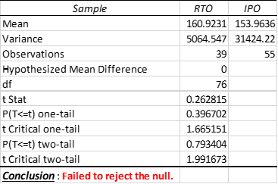
Duration
On average, there is no difference between the duration that takes for the firm to IPO or RTO
This contradicts various literatures
US legal system vs the rest of the world

Slide 19
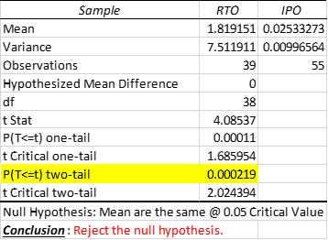
Liquidity
According to the results, reverse-takeover firms have had higher levels of liquidity compared to the IPO firms
These results disagree with consensus literature
This variance can be explained by concentration of sectors in each sample

Slide 20
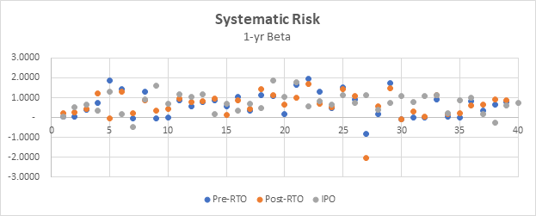
Risk
The results indicate that there no significant difference between the pre-merger beta and the post-merger beta in the RTO sample
Similarly, the evidence shows no difference between the IPO sample and the RTO

Slide 21
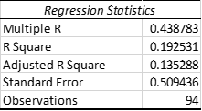
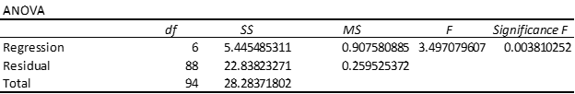
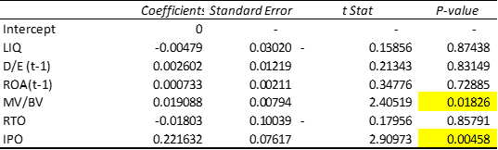
The Abnormal Return

Slide 22
Possible Explanations
IPO firms are backed by a lead underwriter
According to Ellis, Michaely, and O’Hara (2000):
Accounts for 50% of the trading volume in the first 3-months
Overallotment Options value generation
Extensive Inventory position with a position ranging between 4- 25%
Notes:
overallotment options

Slide 23
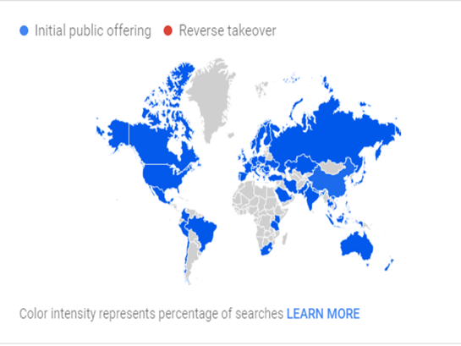
Another Explanation
IPO Buzzword
The difference in demand and supply for both samples globally
IPOs are more attractive compared to RTOs

Slide 24
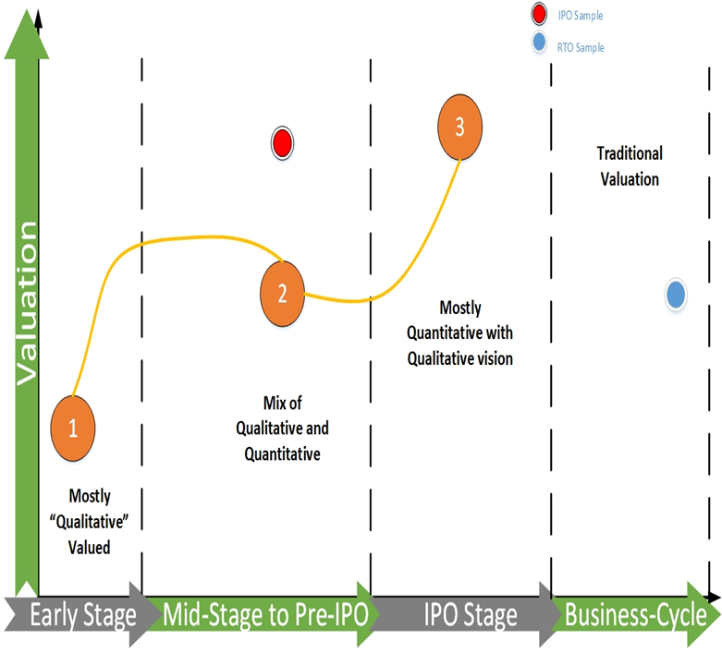
The difference can be explained by the firm stage

Slide 25
Limitations & Considerations for Further Research
Limitations included
the amount of data available on reverse mergers as we were able to only capture data on 56 different reverse mergers which then was reduced to 44
Limited sample size making the model less significant
Further Research
could involve dividing the companies that utilized this means to market into subsections in order to see where the actual value is generated...

Slide 26
Conclusion
In brief…
Once a legacy or trend can be established, the true viability for future companies wishing to apply this listing manner will determine the listing methods utilisation.

Slide 27
Thank you for listening
Questions?

